Slide 1
service-oriented analysis review

Slide 2
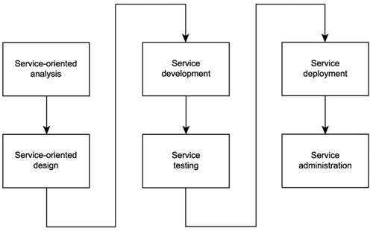
SOA delivery lifecycle

Slide 3
Service-oriented analysis
In this initial stage that we determine the potential scope of our SOA
Service layers are mapped out
Individual services are modeled as service candidates that comprise a preliminary SOA

Slide 4
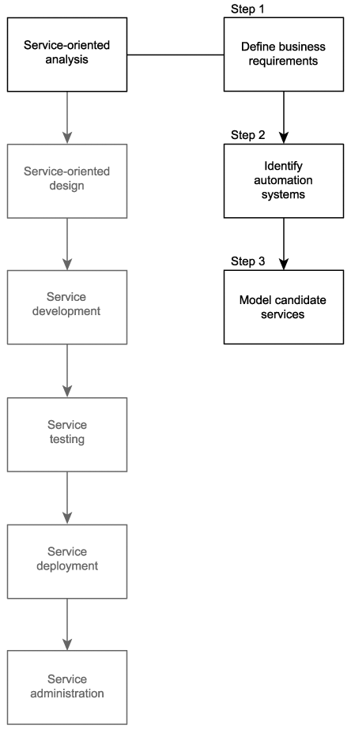

Slide 5
Invoice Submission business process
Accounting clerk creates and issues an electronic invoice using the legacy accounting system.
The save event triggers a custom script that exports an electronic copy of the invoice to a network folder.
A custom developed component, which polls this folder at ten-minute intervals, picks up the document and transforms it into an XML document.
The invoice XML document is then validated. If it is deemed valid, it is forwarded to the Invoice Submission Service. If validation fails, the document is rejected, and the process ends.
Depending on when the last metadata check was performed, the service may issue a Get Metadata request to the TLS B2B solution.
If the Get Metadata request is issued and if it determines that no changes were made to the relevant TLS service descriptions, the Invoice Submission Service transmits the invoice document to the TLS B2B solution using the ExactlyOnce delivery assurance. If the Get Metadata request identifies a change to the TLS service descriptions, the invoice is not submitted, and the process ends.

Slide 6
Order Fulfilment Business process
The RailCo Order Fulfilment Service receives a SOAP message from TLS, containing a payload consisting of a TLS purchase order document.
The service validates the incoming document. If valid, the document is passed to a custom component. If the TLS PO fails validation, a rejection notification message is sent to TLS, and the process ends.
The component has the XML document transformed into a purchase order that conforms to the accounting system's native document format.
The PO then is submitted to the accounting system using its import extension.
The PO ends up in the work queue of an accounting clerk who then processes the document.

Slide 9
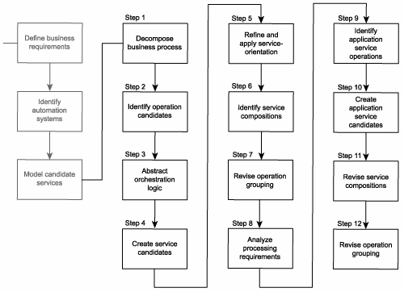
Common steps of modelling process

Slide 10
Step 1: Decompose the business process

Slide 11
Step 1: Decompose the business process
Input: business process document
Output: decomposed business process

Slide 12
Input: Invoice Submission Process
Accounting clerk creates and issues an electronic invoice using the legacy accounting system.
The save event triggers a custom script that exports an electronic copy of the invoice to a network folder.
A custom developed component, which polls this folder at ten-minute intervals, picks up the document and transforms it into an XML document.
The invoice XML document is then validated. If it is deemed valid, it is forwarded to the Invoice Submission Service. If validation fails, the document is rejected, and the process ends.
Depending on when the last metadata check was performed, the service may issue a Get Metadata request to the TLS B2B solution.
If the Get Metadata request is issued and if it determines that no changes were made to the relevant TLS service descriptions, the Invoice Submission Service transmits the invoice document to the TLS B2B solution using the ExactlyOnce delivery assurance. If the Get Metadata request identifies a change to the TLS service descriptions, the invoice is not submitted, and the process ends.

Slide 13
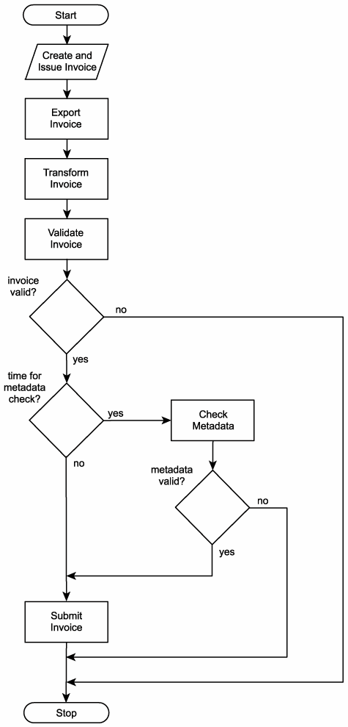
Output: Decomposed Invoice Submission Process
Create electronic invoice.
Issue electronic invoice.
Export electronic invoice to network folder.
Poll network folder.
Retrieve electronic invoice.
Transform electronic invoice to XML document.
Check validity of invoice document. If invalid, end process.
Check if it is time to verify TLS metadata.
If required, perform metadata check. If metadata check fails, end process.

Slide 14
From business process to decomposed business process
Invoice Submission Process
Decomposed Invoice Submission Process
Accounting clerk creates and issues an electronic invoice using the legacy accounting system.
The save event triggers a custom script that exports an electronic copy of the invoice to a network folder.
A custom developed component, which polls this folder at ten-minute intervals, picks up the document and transforms it into an XML document.
The invoice XML document is then validated. If it is deemed valid, it is forwarded to the Invoice Submission Service. If validation fails, the document is rejected, and the process ends.
Depending on when the last metadata check was performed, the service may issue a Get Metadata request to the TLS B2B solution.
If the Get Metadata request is issued and if it determines that no changes were made to the relevant TLS service descriptions, the Invoice Submission Service transmits the invoice document to the TLS B2B solution using the ExactlyOnce delivery assurance. If the Get Metadata request identifies a change to the TLS service descriptions, the invoice is not submitted, and the process ends.
Create electronic invoice.
Issue electronic invoice.
Export electronic invoice to network folder.
Poll network folder.
Retrieve electronic invoice.
Transform electronic invoice to XML document.
Check validity of invoice document. If invalid, end process.
Check if it is time to verify TLS metadata.
If required, perform metadata check. If metadata check fails, end process.

Slide 15
Input: Order Fulfilment Process
The RailCo Order Fulfilment Service receives a SOAP message from TLS, containing a payload consisting of a TLS purchase order document.
The service validates the incoming document. If valid, the document is passed to a custom component. If the TLS PO fails validation, a rejection notification message is sent to TLS, and the process ends.
The component has the XML document transformed into a purchase order that conforms to the accounting system's native document format.
The PO then is submitted to the accounting system using its import extension.
The PO ends up in the work queue of an accounting clerk who then processes the document.

Slide 16
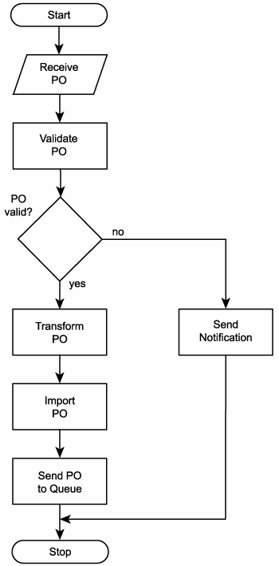
Output: Decomposed Order Fulfilment Process
Receive PO document.
Validate PO document.
If PO document is invalid, send rejection notification and end process.
Transform PO XML document into native electronic PO format.
Import electronic PO into accounting system.
Send PO to accounting clerk's work queue.

Slide 17
From business process to decomposed business process
Order Fulfilment Process
Decomposed Order Fulfilment Process
The RailCo Order Fulfilment Service receives a SOAP message from TLS, containing a payload consisting of a TLS purchase order document.
The service validates the incoming document. If valid, the document is passed to a custom component. If the TLS PO fails validation, a rejection notification message is sent to TLS, and the process ends.
The component has the XML document transformed into a purchase order that conforms to the accounting system's native document format.
The PO then is submitted to the accounting system using its import extension.
The PO ends up in the work queue of an accounting clerk who then processes the document.
Receive PO document.
Validate PO document.
If PO document is invalid, send rejection notification and end process.
Transform PO XML document into native electronic PO format.
Import electronic PO into accounting system.
Send PO to accounting clerk's work queue.

Slide 18
Step 2: Identify business service operation candidates

Slide 19
Step 2: Identify business service operation candidates
Input: decomposed business process
Output: business service operation candidates: filtered out decomposed business process with some steps identified as not belonging to the service oriented solution and others identified as possible service operation candidates

Slide 20
Input: Decomposed Invoice Submission Process
Create electronic invoice.
Issue electronic invoice.
Export electronic invoice to network folder.
Poll network folder.
Retrieve electronic invoice.
Transform electronic invoice to XML document.
Check validity of invoice document. If invalid, end process.
Check if it is time to verify TLS metadata.
If required, perform metadata check. If metadata check fails, end process.

Slide 21
Output: Invoice Submission operation candidates:
Create electronic invoice. (A manual step performed by the accounting clerk.)
Issue electronic invoice. (A manual step performed by the accounting clerk.)
Export electronic invoice to network folder. (Currently a custom developed extension of the legacy system. Could be made part of a generic service candidate.)
Poll network folder. (Currently performed by a custom developed component. Could be made part of a service candidate.)
Retrieve electronic invoice. (Same as previous.)
Transform electronic invoice to XML document. (Same as previous.)
Check validity of invoice document. If invalid, end process. (Is currently being performed as part of the Invoice Submission Service's parsing routine. No foreseeable need to change this.)
Check if it is time to verify TLS metadata. (Is currently being performed as part of the Invoice Submission Service's parsing routine. Looks like a potentially reusable operation candidate. Could be moved to a separate service candidate.)
If required, perform metadata check. If metadata check fails, end process. (Same as previous.)

Slide 22
From decomposed business process to service operation candidates
Decomposed Invoice Submission Process
Invoice Submission operation candidates:
Create electronic invoice.
Issue electronic invoice.
Export electronic invoice to network folder.
Poll network folder.
Retrieve electronic invoice.
Transform electronic invoice to XML document.
Check validity of invoice document. If invalid, end process.
Check if it is time to verify TLS metadata.
If required, perform metadata check. If metadata check fails, end process.
Create electronic invoice. (A manual step performed by the accounting clerk.)
Issue electronic invoice. (A manual step performed by the accounting clerk.)
Export electronic invoice to network folder. (Currently a custom developed extension of the legacy system. Could be made part of a generic service candidate.)
Poll network folder. (Currently performed by a custom developed component. Could be made part of a service candidate.)
Retrieve electronic invoice. (Same as previous.)
Transform electronic invoice to XML document. (Same as previous.)
Check validity of invoice document. If invalid, end process. (Is currently being performed as part of the Invoice Submission Service's parsing routine. No foreseeable need to change this.)
Check if it is time to verify TLS metadata. (Is currently being performed as part of the Invoice Submission Service's parsing routine. Looks like a potentially reusable operation candidate. Could be moved to a separate service candidate.)
If required, perform metadata check. If metadata check fails, end process. (Same as previous.)

Slide 23
Input: Decomposed Order Fulfilment Process
Receive PO document.
Validate PO document.
If PO document is invalid, send rejection notification and end process.
Transform PO XML document into native electronic PO format.
Import electronic PO into accounting system.
Send PO to accounting clerk's work queue.

Slide 24
Output: Order Fulfillment operation candidates
Receive PO document. (Is currently being performed by the Order Fulfillment Service. No foreseeable need to change this.)
Validate PO document. (Same as previous.)
If PO document is invalid, send rejection notification and end process. (Same as previous.)
Transform PO XML document into native electronic PO format. (Currently performed by a custom developed component. Could be made part of a service candidate.)
Import electronic PO into accounting system. (Currently a custom developed extension of the legacy system. Could be made part of a generic service candidate.)
Send PO to accounting clerk's work queue. (Same as previous.)

Slide 25
From decomposed business process to service operation candidates
Decomposed Order Fulfilment Process
Order Fulfillment operation candidates
Receive PO document.
Validate PO document.
If PO document is invalid, send rejection notification and end process.
Transform PO XML document into native electronic PO format.
Import electronic PO into accounting system.
Send PO to accounting clerk's work queue.
Receive PO document. (Is currently being performed by the Order Fulfillment Service. No foreseeable need to change this.)
Validate PO document. (Same as previous.)
If PO document is invalid, send rejection notification and end process. (Same as previous.)
Transform PO XML document into native electronic PO format. (Currently performed by a custom developed component. Could be made part of a service candidate.)
Import electronic PO into accounting system. (Currently a custom developed extension of the legacy system. Could be made part of a generic service candidate.)
Send PO to accounting clerk's work queue. (Same as previous.)

Slide 26
Step 4: Create business service candidates

Slide 27
Step 4: Create business service candidates
Input: business service operation candidates
Output: business service candidates: business service operation candidates grouped into one or more logical contexts

Slide 28
Input: Invoice Submission operation candidates:
Create electronic invoice. (A manual step performed by the accounting clerk.)
Issue electronic invoice. (A manual step performed by the accounting clerk.)
Export electronic invoice to network folder. (Currently a custom developed extension of the legacy system. Could be made part of a generic service candidate.)
Poll network folder. (Currently performed by a custom developed component. Could be made part of a service candidate.)
Retrieve electronic invoice. (Same as previous.)
Transform electronic invoice to XML document. (Same as previous.)
Check validity of invoice document. If invalid, end process. (Is currently being performed as part of the Invoice Submission Service's parsing routine. No foreseeable need to change this.)
Check if it is time to verify TLS metadata. (Is currently being performed as part of the Invoice Submission Service's parsing routine. Looks like a potentially reusable operation candidate. Could be moved to a separate service candidate.)
If required, perform metadata check. If metadata check fails, end process. (Same as previous.)

Slide 29
Input: Order Fulfillment operation candidates
Receive PO document. (Is currently being performed by the Order Fulfillment Service. No foreseeable need to change this.)
Validate PO document. (Same as previous.)
If PO document is invalid, send rejection notification and end process. (Same as previous.)
Transform PO XML document into native electronic PO format. (Currently performed by a custom developed component. Could be made part of a service candidate.)
Import electronic PO into accounting system. (Currently a custom developed extension of the legacy system. Could be made part of a generic service candidate.)
Send PO to accounting clerk's work queue. (Same as previous.)

Slide 30
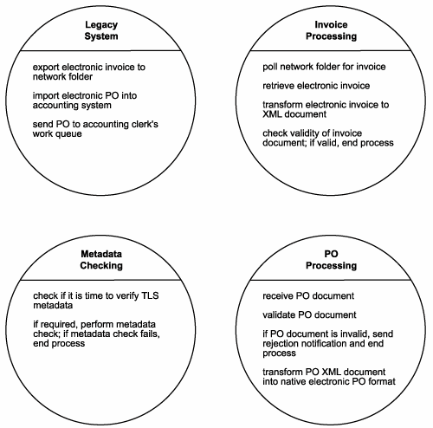
Output: service candidates
Legacy System Service
Export electronic invoice to network folder.
Import electronic PO into accounting system.
Send PO to accounting clerk's work queue.
Invoice Processing Service
Poll network folder for invoice.
Retrieve electronic invoice.
Transform electronic invoice to XML document.
Check validity of invoice document. If invalid, end process.
PO Processing Service
Receive PO document.
Validate PO document.
If PO document is invalid, send rejection notification and end process.
Transform PO XML document into native electronic PO format.
Metadata Checking Service
Check if it is time to verify TLS metadata.
If required, perform metadata check. If metadata check fails, end process.

Slide 31
From service operation candidates to service candidates
Invoice Submission operation candidates:
service candidates
Create electronic invoice. (A manual step performed by the accounting clerk.)
Issue electronic invoice. (A manual step performed by the accounting clerk.)
Export electronic invoice to network folder. (Currently a custom developed extension of the legacy system. Could be made part of a generic service candidate.)
Poll network folder. (Currently performed by a custom developed component. Could be made part of a service candidate.)
Retrieve electronic invoice. (Same as previous.)
Transform electronic invoice to XML document. (Same as previous.)
Check validity of invoice document. If invalid, end process. (Is currently being performed as part of the Invoice Submission Service's parsing routine. No foreseeable need to change this.)
Check if it is time to verify TLS metadata. (Is currently being performed as part of the Invoice Submission Service's parsing routine. Looks like a potentially reusable operation candidate. Could be moved to a separate service candidate.)
If required, perform metadata check. If metadata check fails, end process. (Same as previous.)
Order Fulfillment operation candidates:
Receive PO document. (Is currently being performed by the Order Fulfillment Service. No foreseeable need to change this.)
Validate PO document. (Same as previous.)
If PO document is invalid, send rejection notification and end process. (Same as previous.)
Transform PO XML document into native electronic PO format. (Currently performed by a custom developed component. Could be made part of a service candidate.)
Import electronic PO into accounting system. (Currently a custom developed extension of the legacy system. Could be made part of a generic service candidate.)
Send PO to accounting clerk's work queue. (Same as previous.)

Slide 32
Common steps of modeling process

Slide 33
Step 5: Refine and apply principles of service-orientation
Input: business service candidates: business service operation candidates grouped into one or more logical contexts
Output: revised business service candidates (after applying key service-orientation principles: reusability, autonomy)

Slide 34
Input: service candidates
Legacy System Service
Export electronic invoice to network folder.
Import electronic PO into accounting system.
Send PO to accounting clerk's work queue.
Invoice Processing Service
Poll network folder for invoice.
Retrieve electronic invoice.
Transform electronic invoice to XML document.
Check validity of invoice document. If invalid, end process.
PO Processing Service
Receive PO document.
Validate PO document.
If PO document is invalid, send rejection notification and end process.
Transform PO XML document into native electronic PO format.
Metadata Checking Service
Check if it is time to verify TLS metadata.
If required, perform metadata check. If metadata check fails, end process.

Slide 35
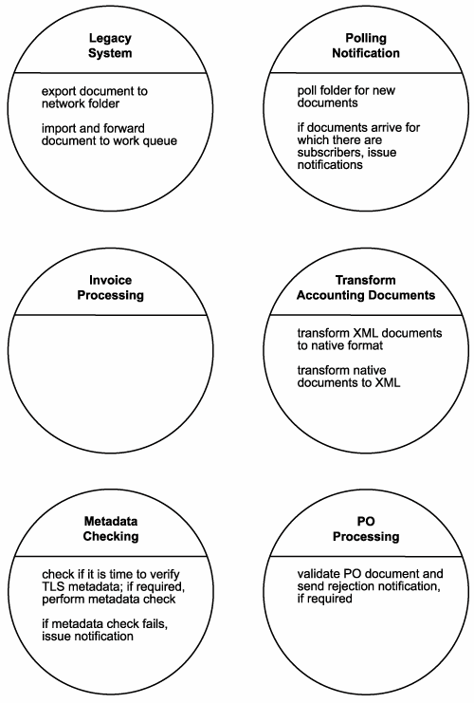
Output: revised service candidates

Slide 36
From service candidates to refined service candidates

Slide 37
Common steps of modeling process

Slide 38
Step 6: Identify candidate service compositions

Slide 39
Input: revised service candidates

Slide 40
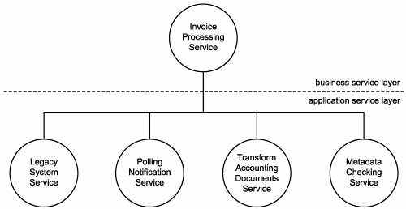
Output: Candidate service compositions
A sample composition representing the Invoice Submission Process.

Slide 41
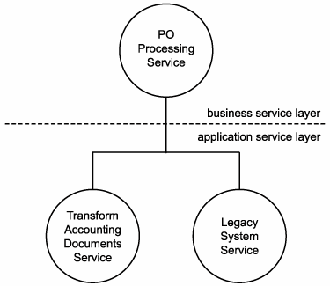
Output: Candidate service compositions
A sample composition representing the Order Fulfillment Process.

Slide 42
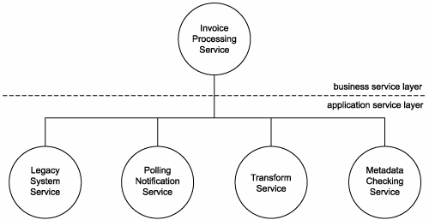
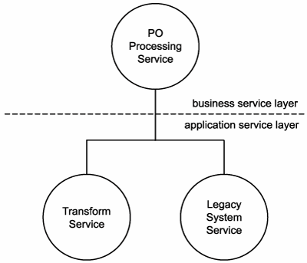
From service candidates to candidate service compositions

Slide 43
Common steps of modeling process

